Slide 1
Welcome!
Sunday
Worship 10:00 AM
Sunday
Bible Class (Livestream) 5:00 PM
Wednesday
Bible Class 7:00 PM
www.SunsetchurchofChrist.net

Slide 2
Opening Prayer | Ryan Sollars
Song – | Craig Foster
Song – | Craig Foster
Lord’s Supper | Michael Hetzer
Song – | Craig Foster
Song – | Craig Foster
Lesson | Brian Haines
Song – 317 | Craig Foster
Closing | Anthony Ward
1 Corinthians 16:2
On the first day of the week let each one of you lay something aside, storing up as he may prosper, that there be no collections when I come.
The collection basket
is in the foyer

Slide 3
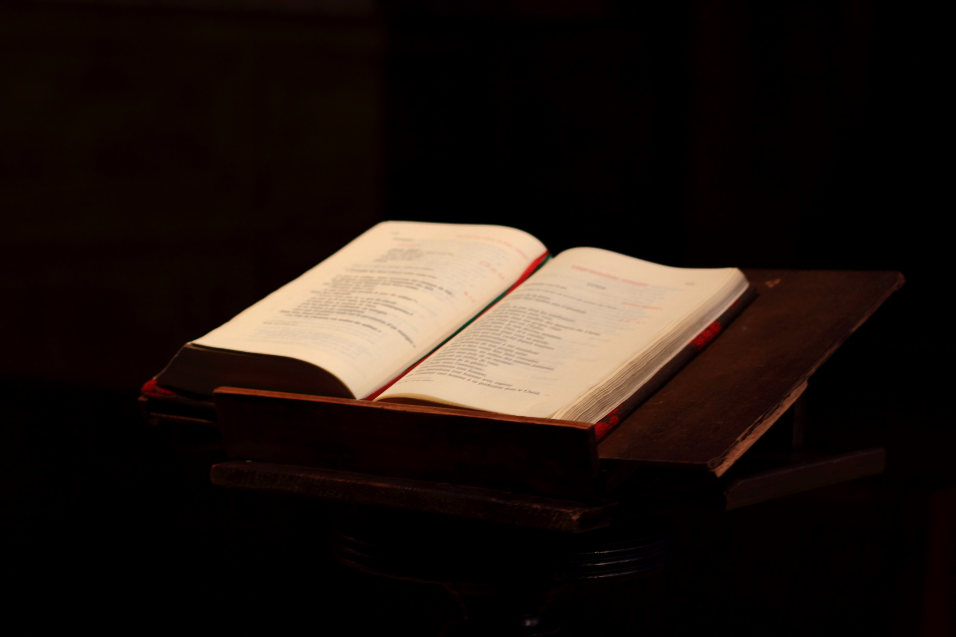
Thoroughly Equipped: Understanding Revelation (Pt 3)

Slide 4
A View of The Temple(11)
Measuring the Temple – Ezekiel 40:3
Gentiles treading underfoot
Outside the temple - Luke 21:24
The olive trees / two witnesses – Zechariah 4:3
Turned water to blood – Moses (Law)
Stopped the rain – Elijah (Prophets)
Notes:
1Pe 4:3 For we have spent enough of our past lifetime in doing the will of the Gentiles--when we walked in lewdness, lusts, drunkenness, revelries, drinking parties, and abominable idolatries.
Lu 21:24 "And they will fall by the edge of the sword, and be led away captive into all nations. And Jerusalem will be trampled by Gentiles until the times of the Gentiles are fulfilled.

Slide 5
A View of The Temple(11)
Measuring the Temple – Ezekiel 40:3
Gentiles treading underfoot
Outside the temple - Luke 21:24
The olive trees / two witnesses – Zechariah 4:3
The Law and the Prophets = Old Testament
Rejecting Christ “slew” them

Slide 6
A War “In Heaven” (12)
Heaven – Heavenly Places
(God) raised us up together, and made us sit together in the heavenly places in Christ Jesus, Ephesians 2:6
Notes:
Heavenly places used 5 times in Ephesians
Eph 1:3 ¶ Blessed be the God and Father of our Lord Jesus Christ, who has blessed us with every spiritual blessing in the heavenly places in Christ,
Eph 1:20 which He worked in Christ when He raised Him from the dead and seated Him at His right hand in the heavenly places,
Eph 2:6 and raised us up together, and made us sit together in the heavenly places in Christ Jesus,
Eph 3:10 to the intent that now the manifold wisdom of God might be made known by the church to the principalities and powers in the heavenly places,
Eph 6:12 For we do not wrestle against flesh and blood, but against principalities, against powers, against the rulers of the darkness of this age, against spiritual hosts of wickedness in the heavenly places.

Slide 7
A War “In Heaven” (12)
Heaven – Heavenly Places
The Woman and Child
THE ELDER, To the elect lady and her children, 2 John 1:1
Notes:
The church is often idenfified as a woman in labor
John 16:21 "A woman, when she is in labor, has sorrow because her hour has come; but as soon as she has given birth to the child, she no longer remembers the anguish, for joy that a human being has been born into the world.
Romans 8:22 For we know that the whole creation groans and labors with birth pangs together until now.
Galatians 4:19 My little children, for whom I labor in birth again until Christ is formed in you,

Slide 8
A War “In Heaven” (12)
Heaven – Heavenly Places
The Woman and Child
"And he who overcomes, and keeps My works until the end, to him I will give power over the nations-- He shall rule them with a rod of iron; They shall be dashed to pieces like the potter's vessels- as I also have received from My Father” Rev. 2:26-27
Notes:
The church is often idenfified as a woman in labor
John 16:21 "A woman, when she is in labor, has sorrow because her hour has come; but as soon as she has given birth to the child, she no longer remembers the anguish, for joy that a human being has been born into the world.
Romans 8:22 For we know that the whole creation groans and labors with birth pangs together until now.
Galatians 4:19 My little children, for whom I labor in birth again until Christ is formed in you,

Slide 9
A War “In Heaven” (12)
Heaven – Heavenly Places
The Woman and Child
The woman is the church
The child is the individual Christian
Notes:
The church is often idenfified as a woman in labor
John 16:21 "A woman, when she is in labor, has sorrow because her hour has come; but as soon as she has given birth to the child, she no longer remembers the anguish, for joy that a human being has been born into the world.
Romans 8:22 For we know that the whole creation groans and labors with birth pangs together until now.
Galatians 4:19 My little children, for whom I labor in birth again until Christ is formed in you,

Slide 10
A War “In Heaven” (12)
Heaven – Heavenly Places
The Woman and Child
The Great Red Dragon (Satan)
Michael
Jude 8-9 (Zechariah 3:2) Daniel 12:1
Notes:
The Drago works through men
1. Jews in Smyrna serve Satan 2:9
2. Satan dwells in Pergamum 2:13
3. Satan's doctrine in Thyatira 2:24
4. Satan's synagogue in Philadelphia 3:9

Slide 11
A War “In Heaven” (12)
Heaven – Heavenly Places
The Woman and Child
The Great Red Dragon
Michael
Victory over the accuser
John 12:31, Luke 10:18
Notes:
Joh 12:31 "Now is the judgment of this world; now the ruler of this world will be cast out.
Lu 10:18 And He said to them, "I saw Satan fall like lightning from heaven.

Slide 12
The Great Beast (13)
Out of the sea (time) the Great Beast

Slide 13
The Great Beast (13)
Out of the sea (time) the Great Beast
Daniel 7:1-14 – Four great world empires
Babylon
Persia
Macedonia
Rome
The Beast that waged war against the Saints is the Empire controlled by the city of Rome
Notes:
In Rev the beast has consumed the other three beasts

Slide 14
The Great Beast (13)
Out of the sea (time) the Great Beast
Daniel 7:1-14 – Four great world empires
Daniel 7:19-25 – The fourth beast
Victory over the great beast
Revelation 14-18
Victory over the great beast

Slide 15
The Lesser Beast (13)
The lesser beast controls the greater
The Emperor of Rome
The Name of the Beast – 666
Imperfection?
Gematria?
Nero Caesar (Rev. 17)
Notes:
Oldest manuscript of revelation has 616, which leads many to believe Nero is the best candidate

Slide 16
The Saved (14)
144,000 saved
CANNOT be literal
Symbolic:
Once more of those delivered
God will punish the oppressor
Notes:
The 144,000 CANNOT be Israelites
Prophecy said they would number more than the stars/sand

Slide 17
The Saved (14)
144,000 saved
Three Angel Proclamation
- Fear God
- Babylon the Great is Fallen
- The guilt of those who submitted
Notes:
1Pe 5:13 She who is in Babylon, elect together with you, greets you; and so does Mark my son.

Slide 18
God’s Wrath on Rome (14-16)
Notes:
1Pe 5:13 She who is in Babylon, elect together with you, greets you; and so does Mark my son.

Slide 19
Plagues of Rome: Revelation 16
Bowl 1: A foul and loathsome sore
Bowl 2: The sea became blood
Bowl 3: Rivers and springs became blood
Bowl 4: The sun scorched men with fire
Bowl 5: The kingdom in darkness
Bowl 6: The river Euphrates dried up
Bowl 7: Lightning and earthquakes
Notes:
1Pe 5:13 She who is in Babylon, elect together with you, greets you; and so does Mark my son.

Slide 20
Plagues of Rome: Revelation 16 | Plagues of Egypt: Exodus 7-11
Bowl 1: A foul and loathsome sore | Plague 6: Boils
Bowl 2: The sea became blood | Plague 1: All water turned to blood
Bowl 3: Rivers and springs became blood
Bowl 4: The sun scorched men with fire | Plague 7: Fiery hail
Bowl 5: The kingdom in darkness | Plague 9: Darkness on the land
Bowl 6: The river Euphrates dried up
Bowl 7: Lightning and earthquakes
Notes:
1Pe 5:13 She who is in Babylon, elect together with you, greets you; and so does Mark my son.

Slide 21
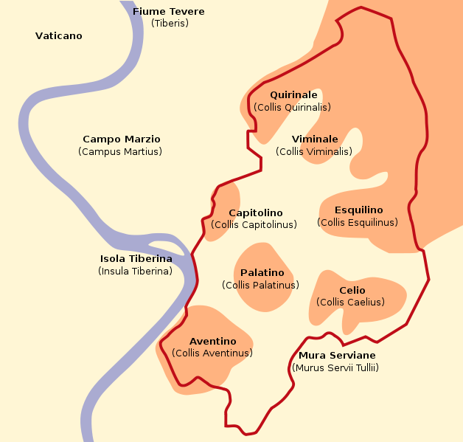
Judgment on Rome (17-18)
Mystery: Babylon the Great, Harlot
- Sits on many waters
- Sits on Seven Hills
- Seven kings
- Ten kings in the future
Zechariah 5:5-11

Slide 23
Judgment on Rome (17-18)
When did Rome “die”?
- Plagues of the 2nd century
- Crisis of the 3rd century
- Constantine’s empire?
- The barbarian invasions?

Slide 24
God Delivers His People
The Lord knows how to deliver the godly out of temptations and to reserve the unjust under punishment for the day of judgment, 2 Peter 2:9
Notes:
Ac 15:11 "But we believe that we are saved through the grace of the Lord Jesus, in the same way as they also are."

Slide 25
The Wedding Feast (19)
The Marriage of the Lamb
Parables of the Kingdom
The church: the Bride of Christ
Ephesians 5:23-32

Slide 26
A 1,000 Year Reign (20)
Millennium: 1,000 Years
Pre-millennial: living BEFORE the 1,000 years
A-millennial: the 1,000 years are not literal
Notes:
Acts 9:1 Then Saul, still breathing threats and murder against the disciples of the Lord, went to the high priest
1 Tim 1:13 although I was formerly a blasphemer, a persecutor, and an insolent man; but I obtained mercy because I did it ignorantly in unbelief.

Slide 27
What Began the 1,000 Years?
(An Angel) laid hold of the dragon, that serpent of old, who is the Devil and Satan, and bound him for a thousand years

Slide 28
The Binding of Satan
John 12:30-33 (2 Corinthians 4:4, Ephesians 2:2)
Matthew 12:28-29 (Isaiah 53)
Hebrews 2:14-15
Notes:
2Co 4:4 whose minds the god of this age has blinded
Eph 2:2 in which you once walked according to the course of this world, according to the prince of the power of the air, the spirit who now works in the sons of disobedience,
Mt 12:28 "But if I cast out demons by the Spirit of God, surely the kingdom of God has come upon you. 29 "Or how can one enter a strong man's house and plunder his goods, unless he first binds the strong man? And then he will plunder his house.

Slide 29
The Binding of Satan
The 1,000 years began with Satan’s binding
Jesus bound Satan at Calvary
This time began (c) AD 30
Notes:
2Co 4:4 whose minds the god of this age has blinded
Eph 2:2 in which you once walked according to the course of this world, according to the prince of the power of the air, the spirit who now works in the sons of disobedience,

Slide 30
How the Saints Reign With Christ
And from Jesus Christ, the faithful witness, the firstborn from the dead, and the ruler over the kings of the earth. To Him who loved us and washed us from our sins in His own blood, and has made us kings and priests to His God and Father, to Him be glory and dominion forever and ever. Amen. Revelation 1:5-6 (NKJV)
“Kings and priests” = basileus and hiereus

Slide 31
How the Saints Reign With Christ
But you are a chosen generation, a royal priesthood, a holy nation, His own special people, that you may proclaim the praises of Him who called you out of darkness into His marvelous light; 1 Peter 2:9
“royal priesthood” = basileus hieteuma
Notes:
Jos 23:10 "One man of you shall chase a thousand,
1Ch 16:15 Remember His covenant forever, The word which He commanded, for a thousand generations,
Ps 50:10 For every beast of the forest is Mine, And the cattle on a thousand hills.

Slide 32
Conclusion
The 1,000 years are described as Christians serving God
In King-Priest Service
Christians serve God in Christ in that way now:
Therefore I urge you, brethren, by the mercies of God, to present your bodies a living and holy sacrifice, acceptable to God, which is your spiritual service of worship. Romans 12:1

Slide 33
What Will End the 1,000 Years?
And I saw the dead, small and great, standing before God, and books were opened. And another book was opened, which is the Book of Life. And the dead were judged according to their works, by the things which were written in the books. The sea gave up the dead who were in it, and Death and Hades delivered up the dead who were in them. And they were judged, each one according to his works. Revelation 20:12-13

Slide 34
What Will End the 1,000 Years?
Then comes the end, when He delivers the kingdom to God the Father, when He puts an end to all rule and all authority and power. For He must reign till He has put all enemies under His feet. The last enemy that will be destroyed is death. 1 Corinthians 15:24-26

Slide 35
Why is it Called 1,000 Years?
2 Peter 3:8-12
1,000 years is not an actual measurement
It represents a great amount of time
Notes:
2Pe 3:8 ¶ But, beloved, do not forget this one thing, that with the Lord one day is as a thousand years, and a thousand years as one day.
9 ¶ The Lord is not slack concerning His promise, as some count slackness, but is longsuffering toward us, not willing that any should perish but that all should come to repentance. 10 But the day of the Lord will come as a thief in the night, in which the heavens will pass away with a great noise, and the elements will melt with fervent heat; both the earth and the works that are in it will be burned up. 11 ¶ Therefore, since all these things will be dissolved, what manner of persons ought you to be in holy conduct and godliness, 12 looking for and hastening the coming of the day of God, because of which the heavens will be dissolved, being on fire, and the elements will melt with fervent heat?

Slide 36
Revelation 21
The Bride of Christ
The ones who overcome all things
The ones who are not found guilty
The Holy Mountain and Holy Jerusalem
Founded on the Apostles and Christ
Ephesians 2:19-20

Slide 37
Revelation 22
The River of Life
Then he brought me back to the door of the temple; and there was water, flowing from under the threshold of the temple toward the east, for the front of the temple faced east; the water was flowing from under the right side of the temple, south of the altar. Ezekiel 47:1

Slide 38
Revelation 22
The River of Life
The Tree of Life
The Certification of the Covenant of Christ

Slide 39
Our Eternal Hope
Revelation reminds us:
- Whatever happens, God is over all
In our lives – Philippians 4:6-7
In the church – 1 Corinthians 3:6-11
In our world – Romans 12:17-21
Notes:
Php 4:6 Be anxious for nothing, but in everything by prayer and supplication, with thanksgiving, let your requests be made known to God; 7 and the peace of God, which surpasses all understanding, will guard your hearts and minds through Christ Jesus.

Slide 40
Our Eternal Hope
Revelation reminds us:
- Whatever happens, God is over all
Whatever happens, we have a home
Our hope of resurrection – Acts 24:15
Our hope of heaven – John 14:1-3
Notes:
Ac 24:15 "I have hope in God, which they themselves also accept, that there will be a resurrection of the dead, both of the just and the unjust.
Joh 14:1 ¶ "Let not your heart be troubled; you believe in God, believe also in Me. 2 "In My Father's house are many mansions; if it were not so, I would have told you. I go to prepare a place for you. 3 "And if I go and prepare a place for you, I will come again and receive you to Myself; that where I am, there you may be also.

Slide 41
Our Eternal Hope
Revelation reminds us:
- Whatever happens, God is over all
Whatever happens, we have a home
Whatever happens, we must be righteous
Faithful until death – Revelation 2:10
Notes:
Re 2:10 "Do not fear any of those things which you are about to suffer. Indeed, the devil is about to throw some of you into prison, that you may be tested, and you will have tribulation ten days. Be faithful until death, and I will give you the crown of life.

Slide 43
2 Deaths, 2 Resurrections
Blessed and holy is the one who has a part in the first resurrection; over these the second death has no power Revelation 20:6a

Slide 44
2 Deaths, 2 Resurrections
The First Death:
And you were dead in your trespasses and sins, Ephesians 2:1
The Second Death:
And death and hell were cast into the lake of fire. This is the second death. Revelation 20:14

Slide 45
2 Deaths, 2 Resurrections
The First Death: Symbolic in Sin
And you were dead in your trespasses and sins, Ephesians 2:1
The Second Death: Literally in Hell
And death and hell were cast into the lake of fire. This is the second death. Revelation 20:14

Slide 46
2 Deaths, 2 Resurrections
The First Resurrection:
having been buried with Him in baptism, in which you were also raised up with Him through faith in the working of God, Colossians 2:12
The Second Resurrection:
In order that I may attain to the resurrection from the dead. Philippians 3:11

Slide 47
2 Deaths, 2 Resurrections
The First Resurrection: Baptism
having been buried with Him in baptism, in which you were also raised up with Him through faith in the working of God, Colossians 2:12
The Second Resurrection: Literal Resurrection
In order that I may attain to the resurrection from the dead. Philippians 3:11

Slide 48
2 Deaths, 2 Resurrections
Blessed and holy is he who has part in the first resurrection (BAPTISM). Over such the second death (HELL) has no power, but they shall be priests of God and of Christ, and shall reign with Him a thousand years. Revelation 20:6

